Slide 1


Social Buzz

Slide 2


Today's agenda
Project recap
Problem
The Analytics team
Process
Insights
Summary

Slide 3

To start our engagement with Social Buzz, we are running a 3 month initial project in order to prove to them that we are the best firm to work with. They are expecting the following:
An audit of their big data practice.
Recommendations for a successful IPO.
An analysis of their content categories that highlights the top 5 categories with the largest aggregate popularity.
Project Recap

Slide 4


Problem
Over 100000 posts per day
36,500,000 pieces of content per year!
How to capitalize on it when there is so much?
Analysis to find Social Buzz’s top 5 most popular categories of content

Slide 5
Andrew Fleming Chief Technical Architect
1
The Analytics team
2
Marcus Rompton Senior Principle
3
Shreya Dutta Data Analyst

Slide 6
Analysing the problem statement – Data Understanding
Process
1
2
Data Cleaning
3
Data Modelling
4
Data Analysis
5
Uncover Insights

Slide 7

Insights
To know the top 5 categories, the best way to represent it is in a bar chart by converting the values into probabilities.
The bar chart gives a visualization of the most as well as the least popular content categories clearly.
The top 5 categories are : Animals, science, healthy eating, technology and food. The graph is shown in the next slide.

Slide 8
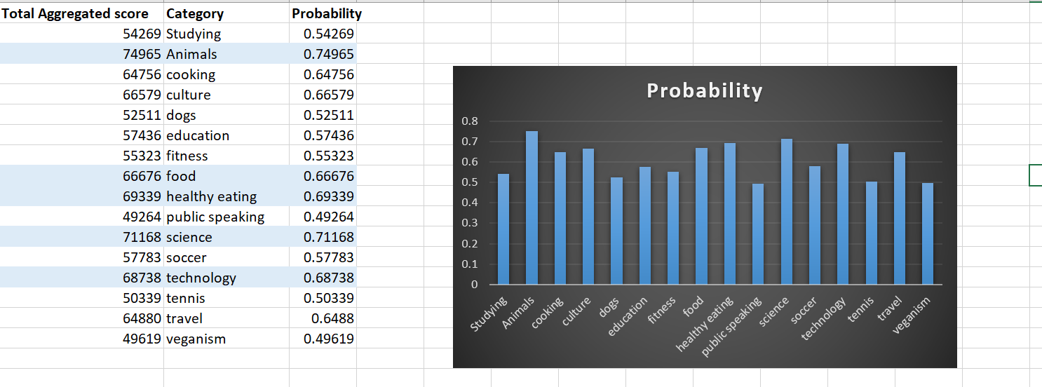

Slide 9
There are sixteen unique categories. They are:
Animals, cooking, culture, dogs, education, fitness, food, healthy eating, public speaking, science, soccer, technology, tennis, travel, veganism.
2. The most popular category is Animals and the number of reactions received for this category is 74,965 reactions.
3. The month of August was the month with the most posts.

Slide 10

Top 5 content categories were found.
Summary
Most popular category is Animals. It received the most number of reactions too.
Most number of reactions were posted in the month of August.

Slide 11

Thank you!
ANY QUESTIONS?

